Slide 1
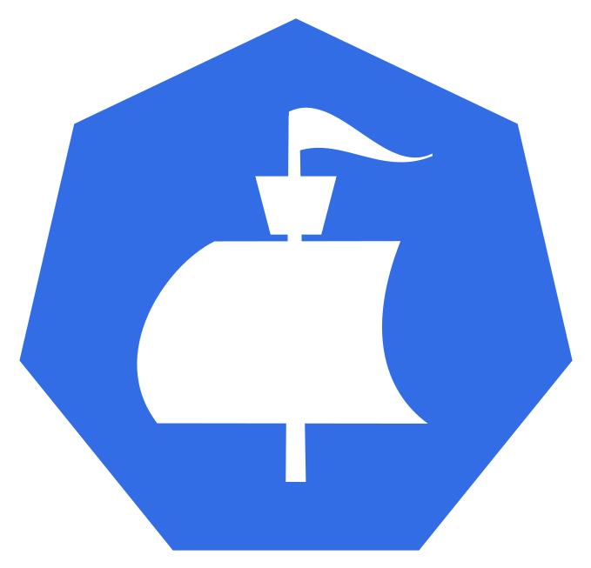
Moonraker
Visualizing Cloud Native Application Bundles
Chance Murray, Dan Kindt, Gabe Coelho, Grant Purdue & Madison Robertson

Slide 2
Top Use Cases
DevOps: multiple containers, multiple servers
DevOps: multiple containers, one server
SRE: Porter, Duffle and/or Docker App
Notes:
We are going through our second scenario, because of our sponsor’s dependency.

Slide 3
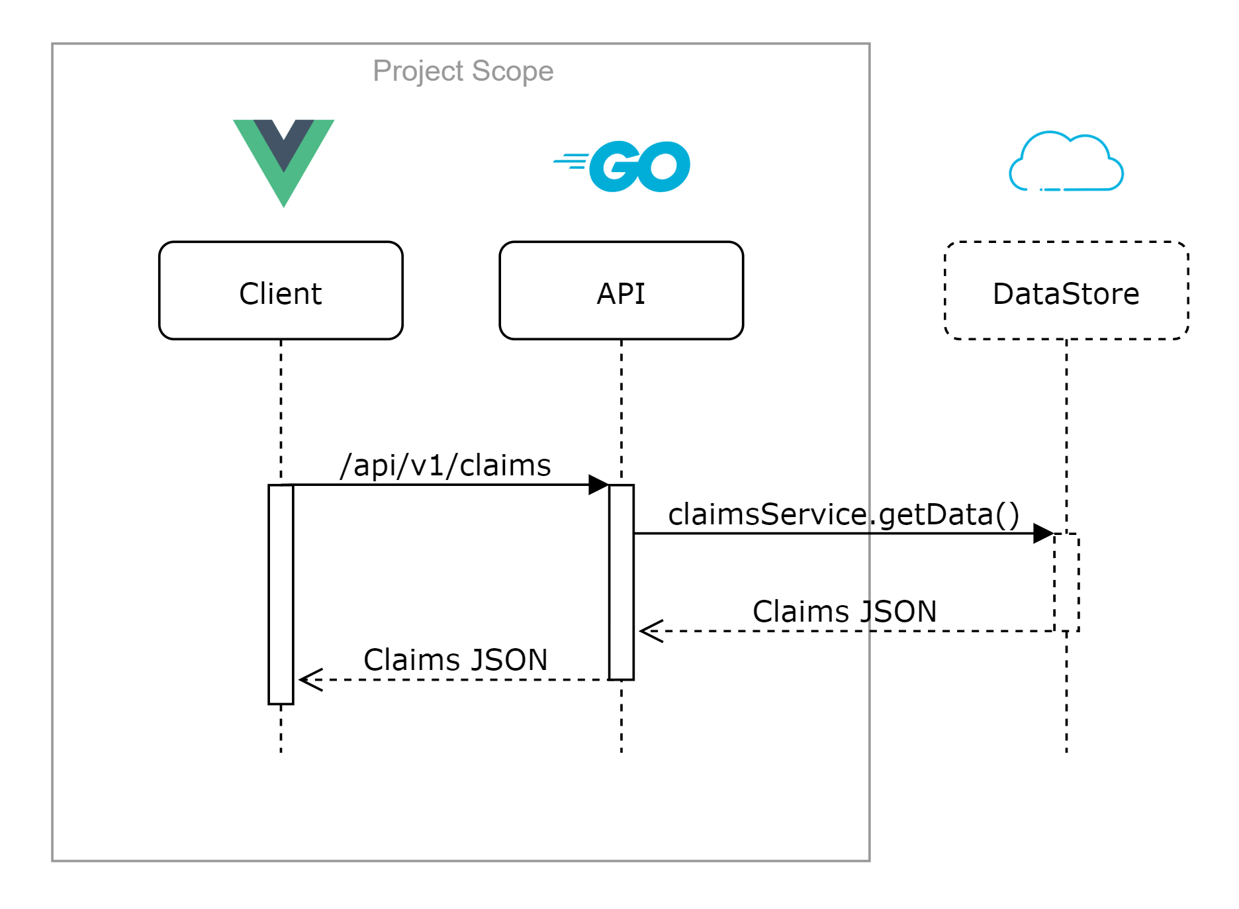
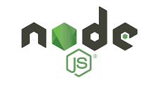
Changes to Design: Before
Dependency:
Cloud plugin from sponsor
Risk:
Integration with tool at end of project

Slide 4

Changes to Design: Now
Solution:
Integrating both local file and cloud plugin compatibility

Slide 5
Demo

Slide 6
Project Status
On Schedule

